Slide 1



Search for $t\overline{t}Z^{′}→t\overline{t}t\overline{t}$ production in the multilepton final state in $pp$ collisions at $\sqrt{s}=13$ TeV with the ATLAS detector
Hieu Le
Dissertation Defense - August 4th, 2025
Thesis committee
Reinhard Schwienhorst*
Wade Fisher
Johannes Pollanen
Remco Zegers
Yuying Xie

Slide 2



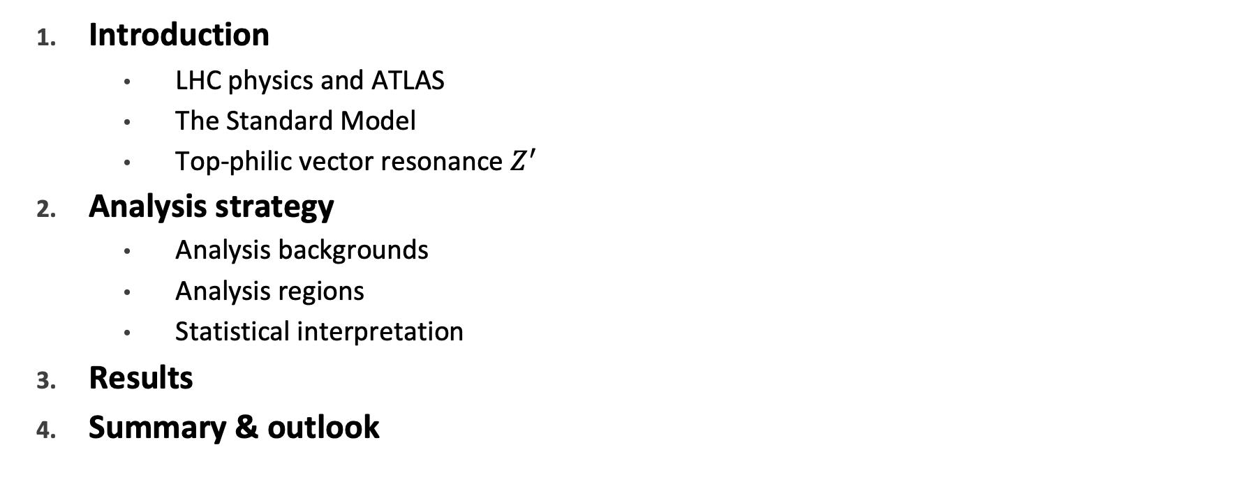
Contents
Introduction
LHC physics and ATLAS
The Standard Model
Top-philic vector resonance $Z^{′}$
Analysis strategy
Analysis backgrounds
Analysis regions
Statistical interpretation
Results
Summary & outlook

Slide 3
Introduction

Slide 4
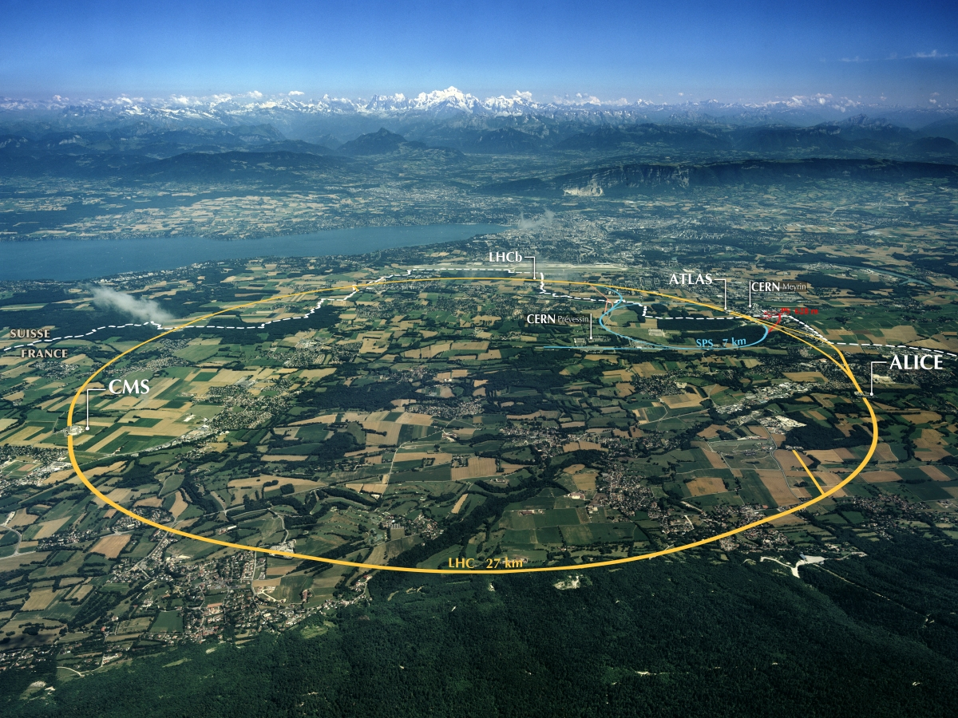
The Large Hadron Collider
Currently the world’s largest and most powerful particle accelerator
27km (~17 miles) circumference
Built by CERN at the Swiss-French border
Main experiments: ATLAS, CMS, LHCb, ALICE
ATLAS & CMS: general purpose detector
Operates in periods of data-taking (runs) and shut-downs for upgrades
Notes:
a toroidal lhc apparatus
potential for 14 GeV
detectors also collision points

Slide 5
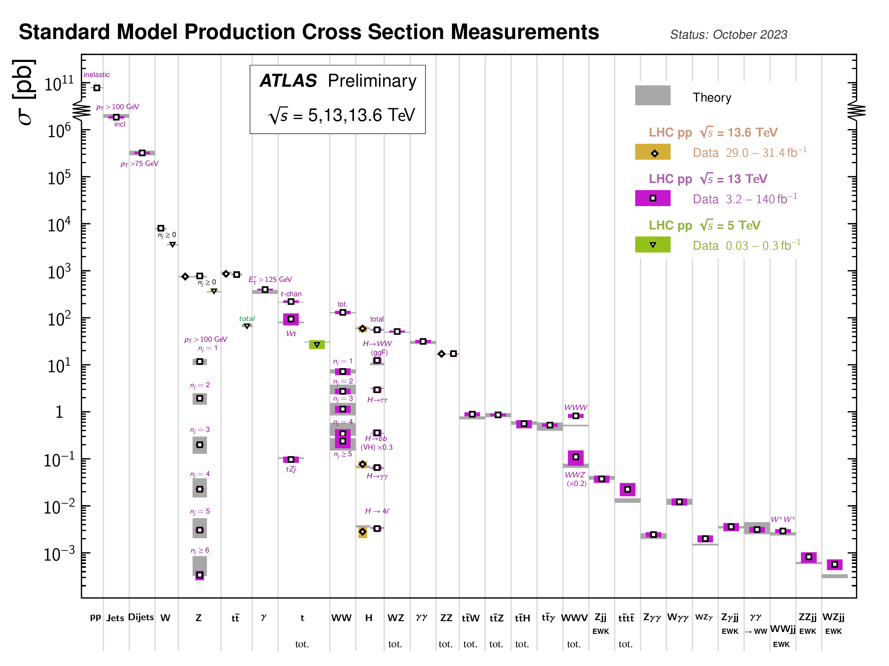
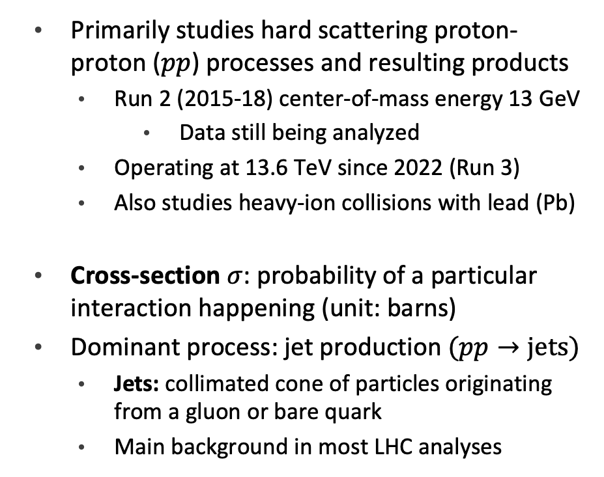
Physics at the LHC
Primarily studies hard scattering proton-proton ($pp$) processes and resulting products
Run 2 (2015-18) center-of-mass energy 13 GeV
Data still being analyzed
Operating at 13.6 TeV since 2022 (Run 3)
Also studies heavy-ion collisions with lead (Pb)
Cross-section $σ$: probability of a particular interaction happening (unit: barns)
Dominant process: jet production $(pp→jets)$
Jets: collimated cone of particles originating from a gluon or bare quark
Main background in most LHC analyses
Notes:
data constantly analyzed thanks to improvements in particle ID, flavor tagging, improved detector modeling and analysis software infrastructure

Slide 6
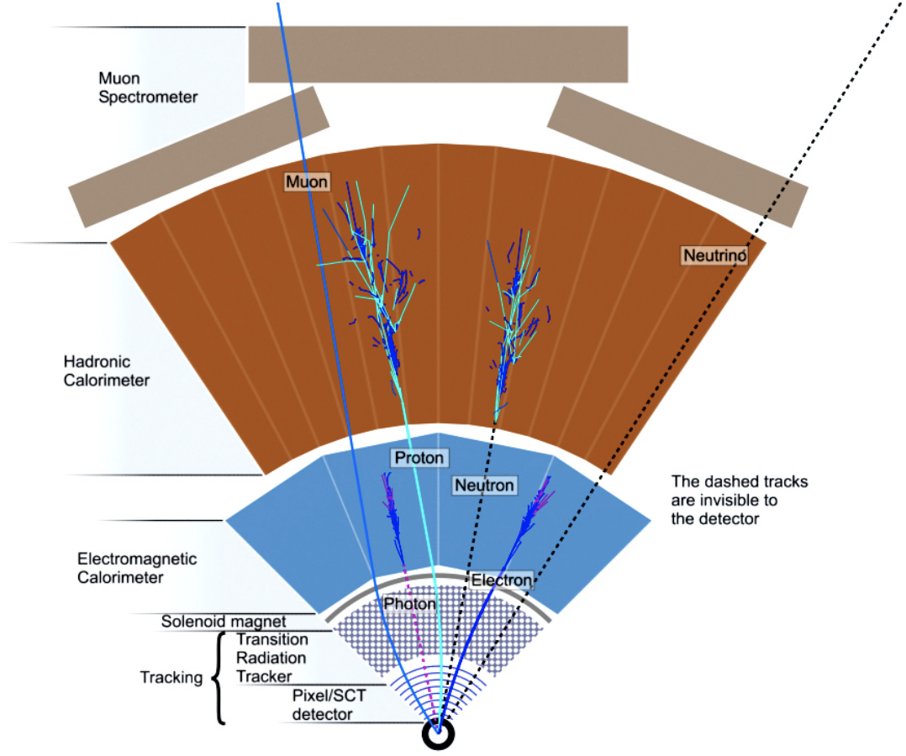
The ATLAS detector: Overview
Multi-purpose cylindrical detector
Concentric around beamline with collision point at the center
Main subsystems
Inner detector
track & vertex reconstruction
Calorimeter (electromagnetic & hadronic)
energy deposition measurement
Muon spectrometer
Notes:
a toroidal lhc apparatus
potential for 14 GeV
pT always associated with an interaction vertex
missing transverse energy

Slide 7
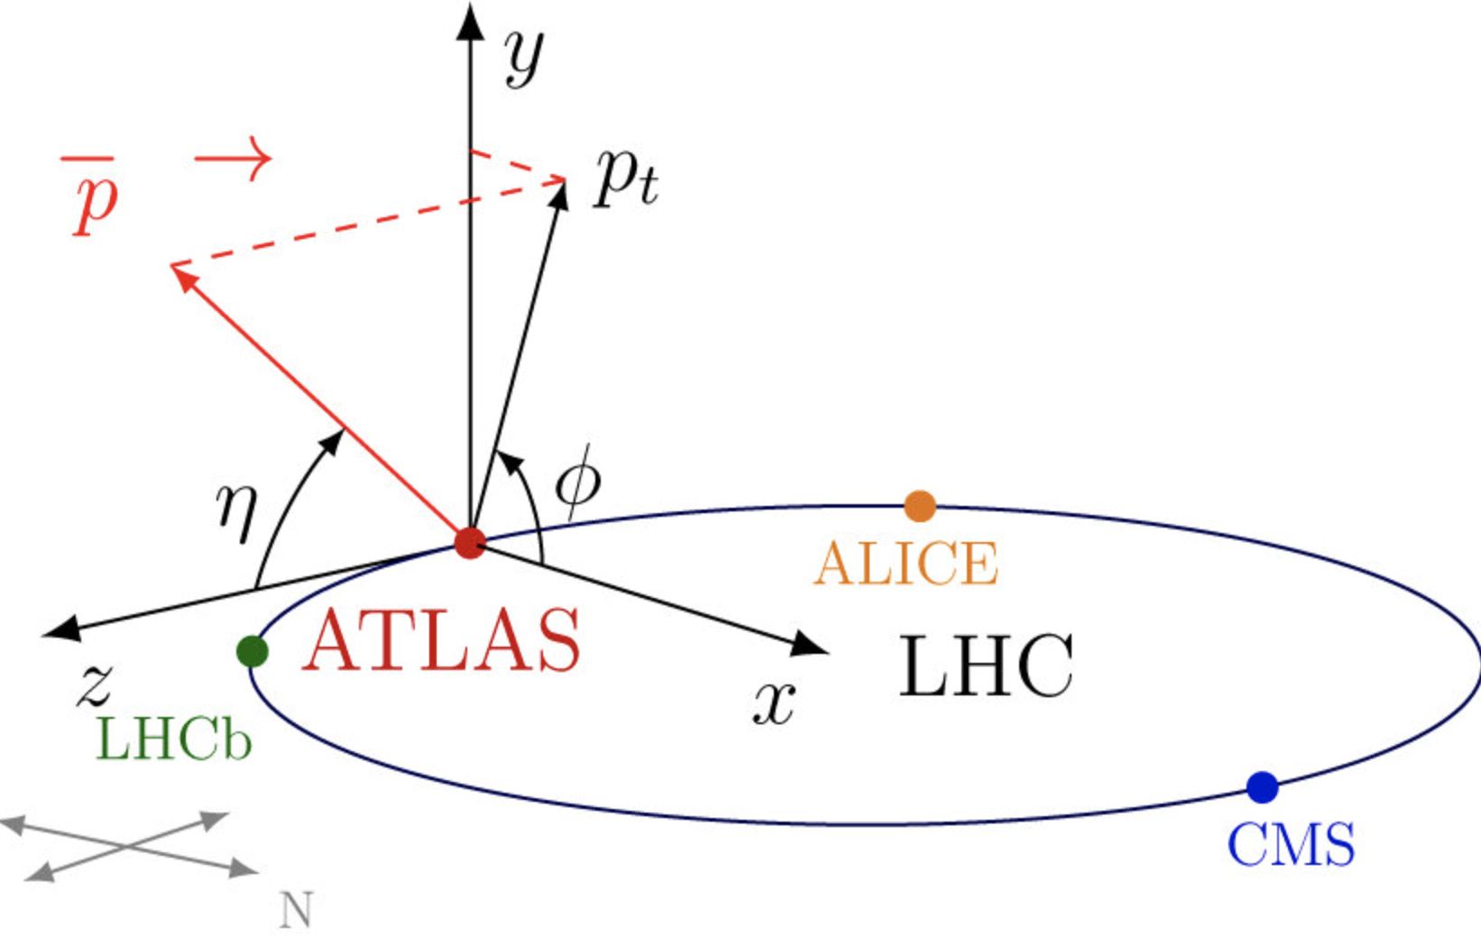
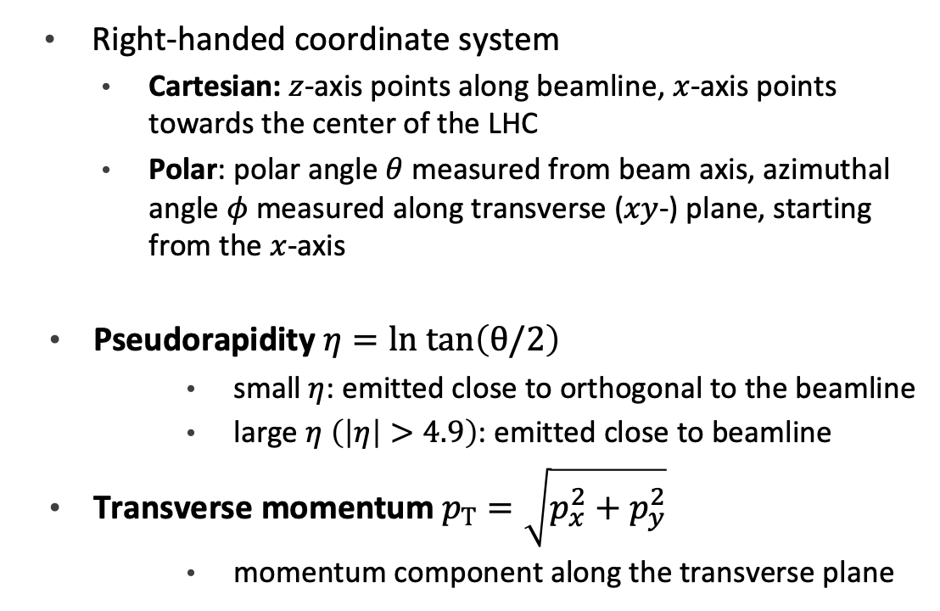
The ATLAS detector: Coordinate system
Right-handed coordinate system
Cartesian: $z$-axis points along beamline, $x$-axis points towards the center of the LHC
Polar: polar angle $θ$ measured from beam axis, azimuthal angle $φ$ measured along transverse ($xy$-) plane, starting from the $x$-axis
Pseudorapidity $η=ln tan\left(θ/2\right)$
small $η$: emitted close to orthogonal to the beamline
large $η$ $\left(\left|η\right|>4.9\right)$: emitted close to beamline
Transverse momentum $p_{T}=\sqrt{p_{x}^{2}+p_{y}^{2}}$
momentum component along the transverse plane
Notes:
units: natural units, c=h=1, energy in TeV/c^2

Slide 8
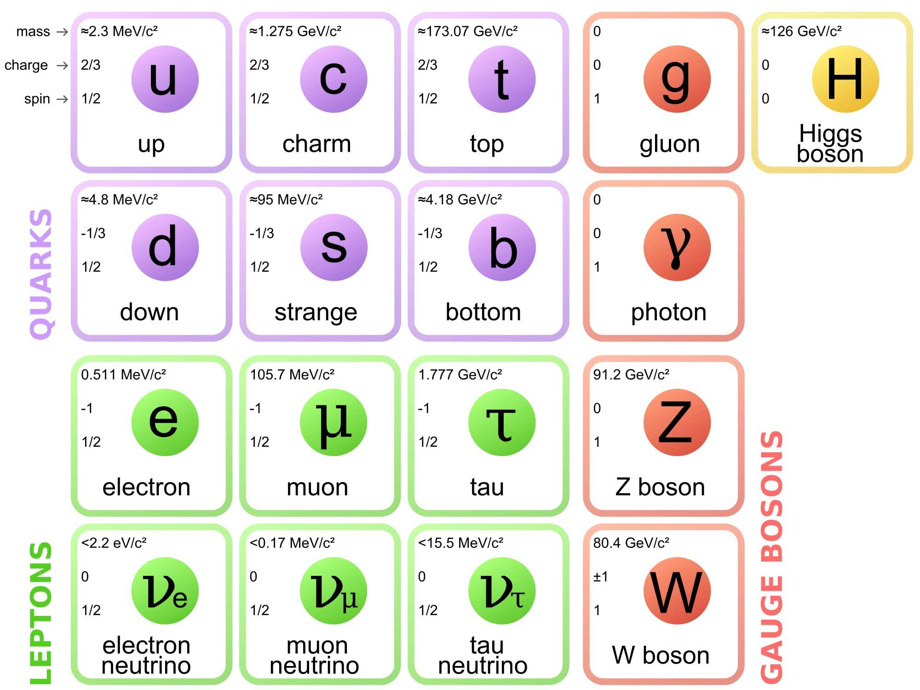
The Standard Model: Elementary particles
Currently the most successful formalism to describe the physical world
Two classes of particles
Fermions: building blocks of matter
half-spin, follows Fermi-Dirac statistics
quarks & leptons: 6 flavors grouped into 3 generations
quarks cannot exist in a vacuum due to color confinement
Bosons: fundamental force mediators
integer-spin, follows Bose-Einstein statistics
scalar boson (spin-0) & vector bosons (spin-1)
Notes:
color confinement -> hadronization

Slide 9
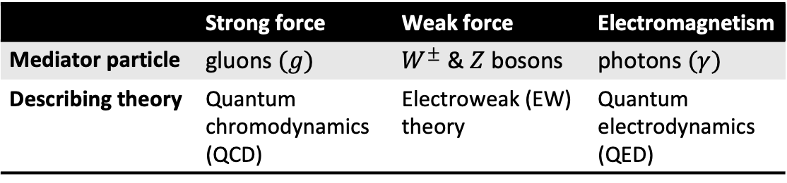
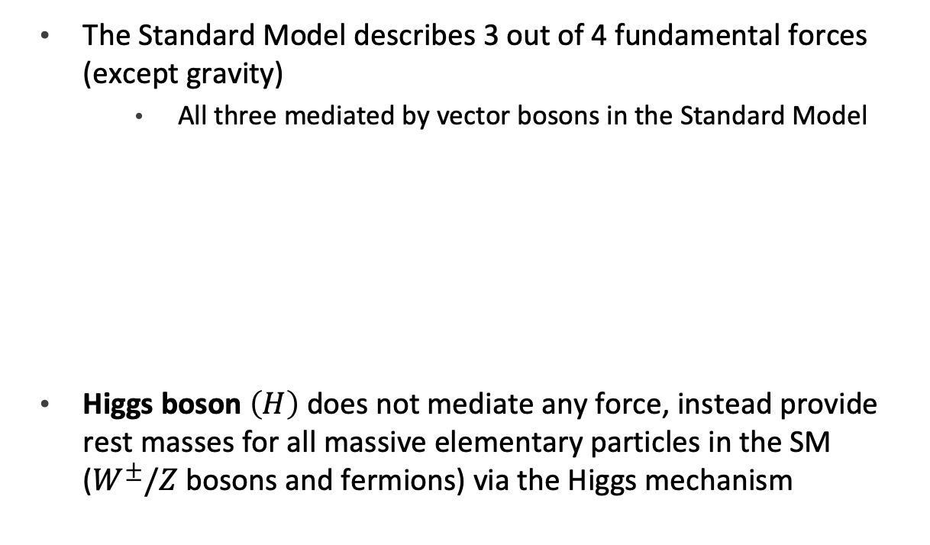
The Standard Model: Fundamental forces
The Standard Model describes 3 out of 4 fundamental forces (except gravity)
All three mediated by vector bosons in the Standard Model
Higgs boson $\left(H\right)$ does not mediate any force, instead provide rest masses for all massive elementary particles in the SM ($W^{±}/Z$ bosons and fermions) via the Higgs mechanism
 | Strong force | Weak force | Electromagnetism
Mediator particle | gluons $(g)$ | $W^{±}$ & $Z$ bosons | photons $(γ)$
Describing theory | Quantum chromodynamics (QCD) | Electroweak (EW) theory | Quantum electrodynamics (QED)
Notes:
EW theory also describes electromagnetism in the form of an unification with weak interaction above the EW symmetry breaking scale

Slide 10
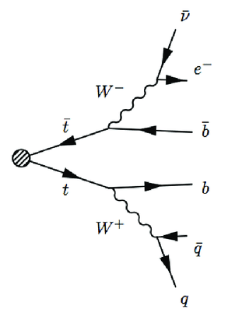
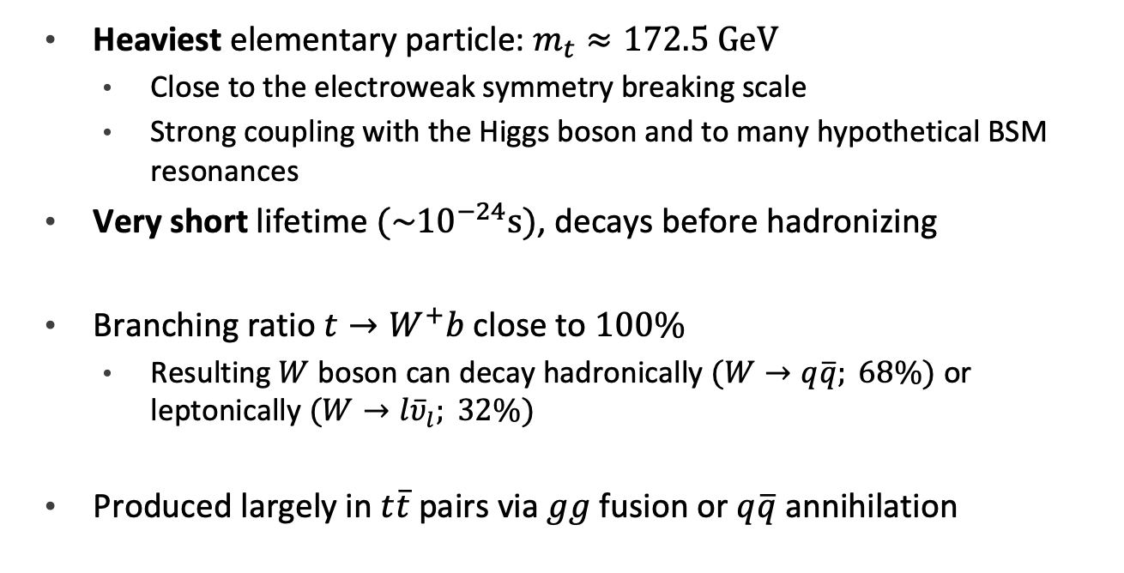
Top quark
Heaviest elementary particle: $m_{t}≈172.5 GeV$
Close to the electroweak symmetry breaking scale
Strong coupling with the Higgs boson and to many hypothetical BSM resonances
Very short lifetime $(\sim {10}^{−24}s)$, decays before hadronizing
Branching ratio $t→W^{+}b$ close to $100\%$
Resulting $W$ boson can decay hadronically $(W→q\overline{q}; 68\%)$ or leptonically $(W→l{\overline{υ}}_{l}; 32\%)$
Produced largely in $t\overline{t}$ pairs via $gg$ fusion or $q\overline{q}$ annihilation
Notes:
next largest particle: Higgs 125 GeV; fermion b-quark 4 GeV
heavy top mass unexplained, many BSM theories predict exotic couplings

Slide 11
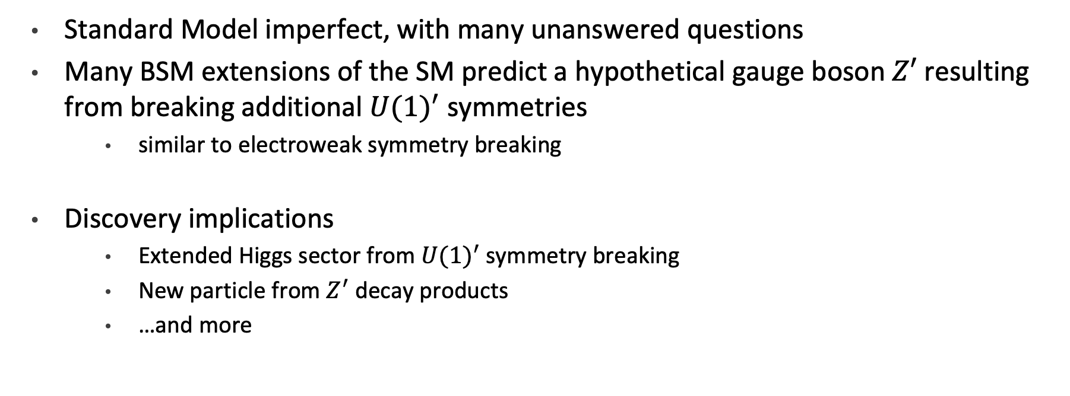

Beyond the Standard Model – $Z′$ boson
Standard Model imperfect, with many unanswered questions
Many BSM extensions of the SM predict a hypothetical gauge boson $Z′$ resulting from breaking additional ${U(1)}^{′}$ symmetries
similar to electroweak symmetry breaking
Discovery implications
Extended Higgs sector from ${U(1)}^{′}$ symmetry breaking
New particle from $Z^{′}$ decay products
…and more
Notes:
SM unanswered question: dark matter, neutrino mass, matter-antimatter asymmetry, unification of strong and EW forces
new physics avenues: extended higgs sector from U(1)’ symmetry breaking, exotic production from Z’ decays

Slide 12
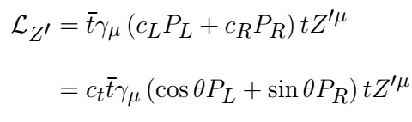
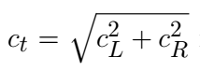
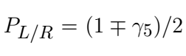
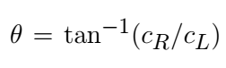
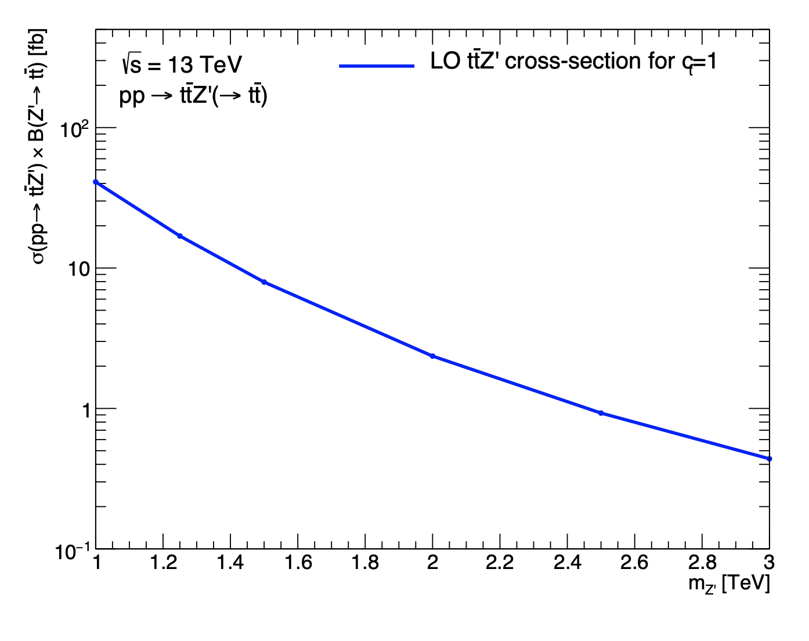
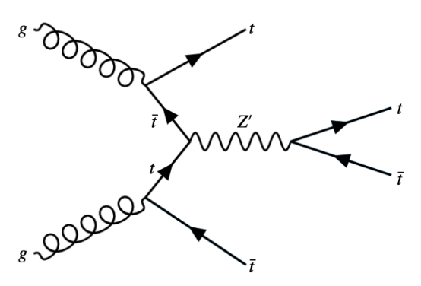
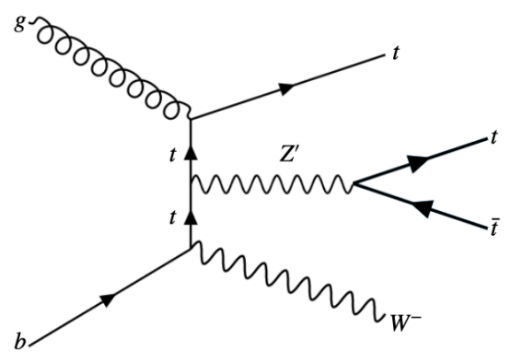
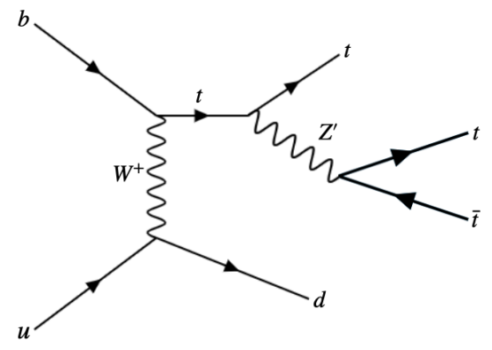
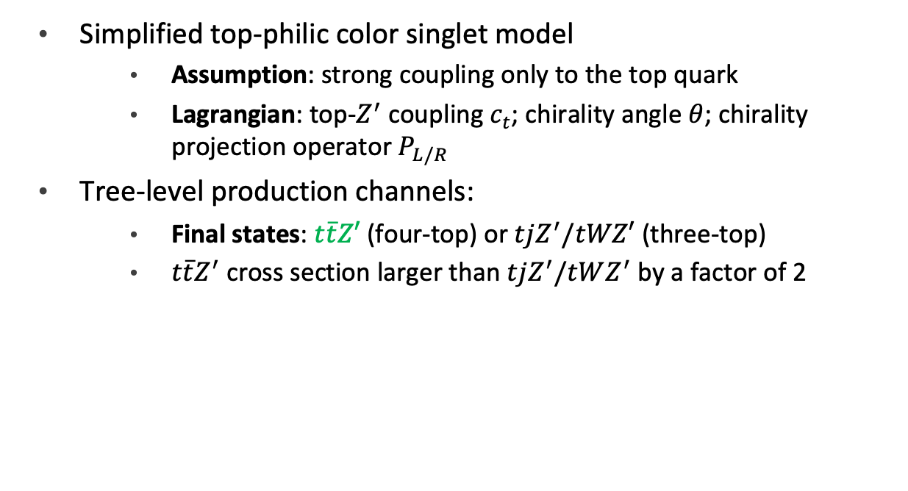
Top-philic vector particle model
Simplified top-philic color singlet model
Assumption: strong coupling only to the top quark
Lagrangian: top-$Z^{′}$ coupling $c_{t}$; chirality angle $θ$; chirality projection operator $P_{L/R}$
Tree-level production channels:
Final states: $t\overline{t}Z′$ (four-top) or $tjZ^{′}/tWZ′$ (three-top)
$t\overline{t}Z^{′}$ cross section larger than $tjZ^{′}/tWZ^{′}$ by a factor of 2
Notes:
singlet = spin 0
strong coupling in decay and production
also loop level production, heavily depends on model choice
suppressed by choice of chirality angle
tjZ’/tWZ’ suppressed minmally under left handed interaction (theta=0)

Slide 13
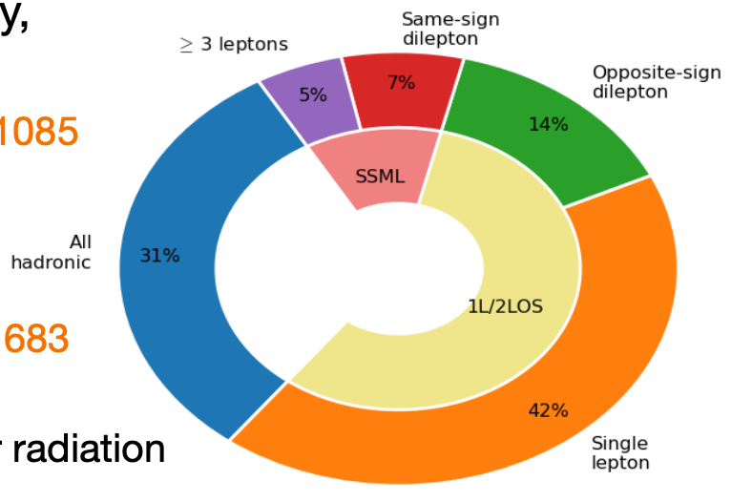

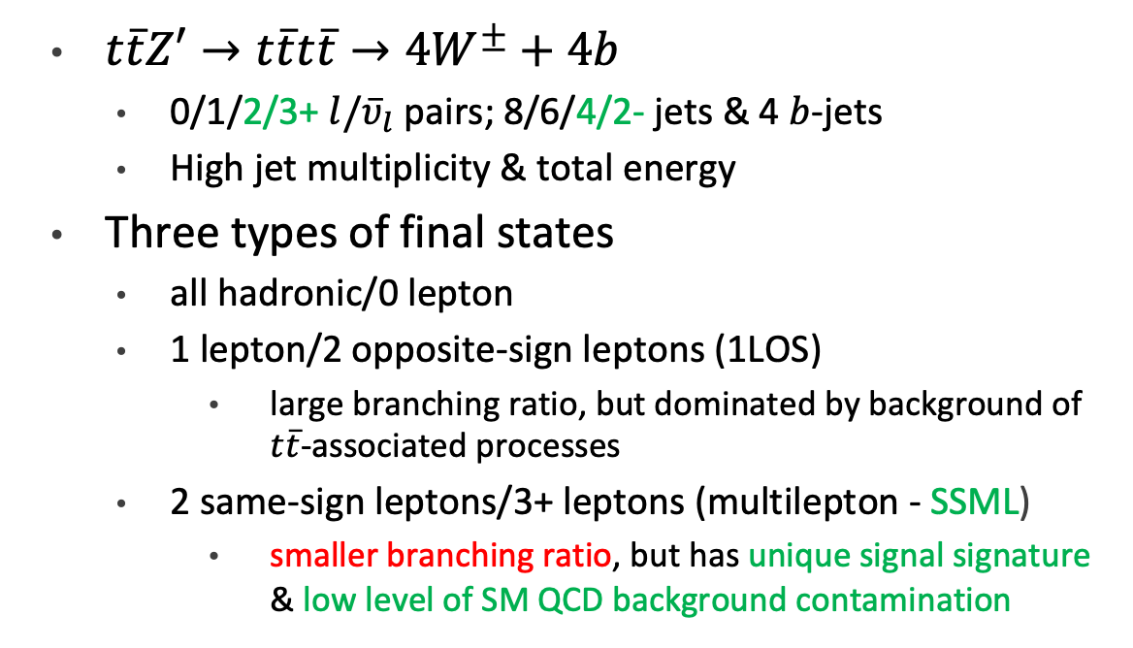
Decay channels: $t\overline{t}Z^{′}$
$t\overline{t}Z′→t\overline{t}t\overline{t}→4W^{±}+4b$
0/1/2/3+ $l{/\overline{υ}}_{l}$pairs; 8/6/4/2- jets & 4 $b$-jets
High jet multiplicity & total energy
Three types of final states
all hadronic/0 lepton
1 lepton/2 opposite-sign leptons (1LOS)
large branching ratio, but dominated by background of $t\overline{t}$-associated processes
2 same-sign leptons/3+ leptons (multilepton - SSML)
smaller branching ratio, but has unique signal signature & low level of SM QCD background contamination
Notes:
products also include MET from neutrinos
lepton = muon or electron
most taus decay hadronically, harder to reconstruct since they look like regular jets
lower tau identification efficiency
complex modeling

Slide 14
Analysis strategy

Slide 15
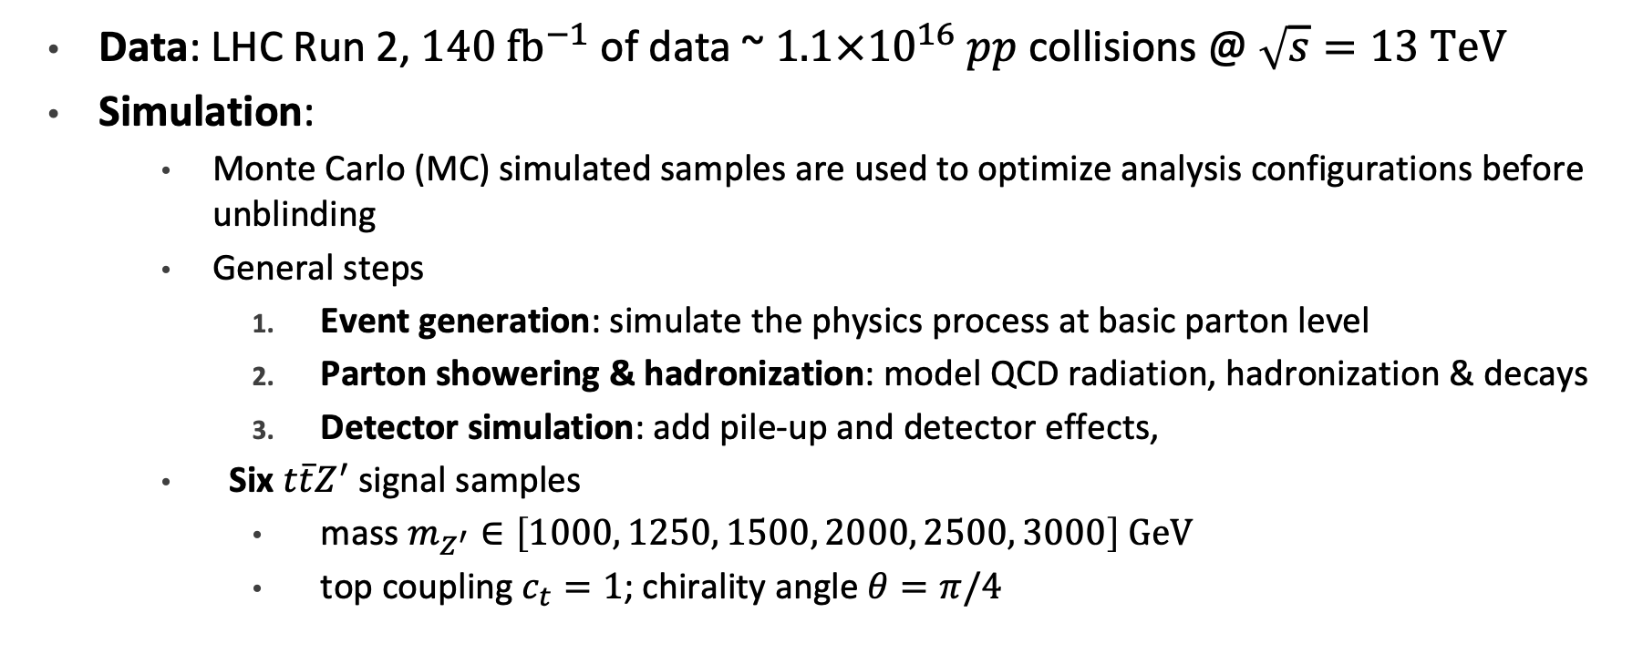
Analysis samples
Data: LHC Run 2, $140 {fb}^{−1}$ of data ~ $1.1×{10}^{16}$ $pp$ collisions @ $\sqrt{s}=13 TeV$
Simulation:
Monte Carlo (MC) simulated samples are used to optimize analysis configurations before unblinding
General steps
Event generation: simulate the physics process at basic parton level
Parton showering & hadronization: model QCD radiation, hadronization & decays
Detector simulation: add pile-up and detector effects,
Six $t\overline{t}Z^{′}$ signal samples
mass $m_{Z^{′}}∈\left[1000, 1250, 1500, 2000, 2500, 3000\right] GeV$
top coupling $c_{t}=1$; chirality angle $θ=π/4$
Notes:
Run 2: 2015-2018
simulation based on Run 2 configurations
analysis optimizations: estimate sensitivity, profile physics background, validate modeling and estimation methods, optimize object definitions and selections
event generation: input = matrix elements + parton distribution function
matrix element: quantum probability amplitude of a process, |M|^2 = interaction probability, depends on physics objects, couplings & QCD order
pdf: probability of finding a parton carrying a fraction of the containing proton momentum when probed at a momentum scale
parton level simulation: simulating hard scattering process between quarks & gluons before radiation, hadronization or interaction with detector
missing: parton showers (initial/final state QCD radiation), hadronization (baryon formation), decays, pileup & detector effects
parton showering: interfaced with tune = configure PS model with a set of optimized parameters tuned to reproduce experimental data e.g. Tevatron, LHC
detector sim: full or fast sim
at this stage, output mimics real ATLAS readout signals
top coupling = 1 for narrow resonance peak, resonance width ~4%
chirality angle to suppress loop production

Slide 16
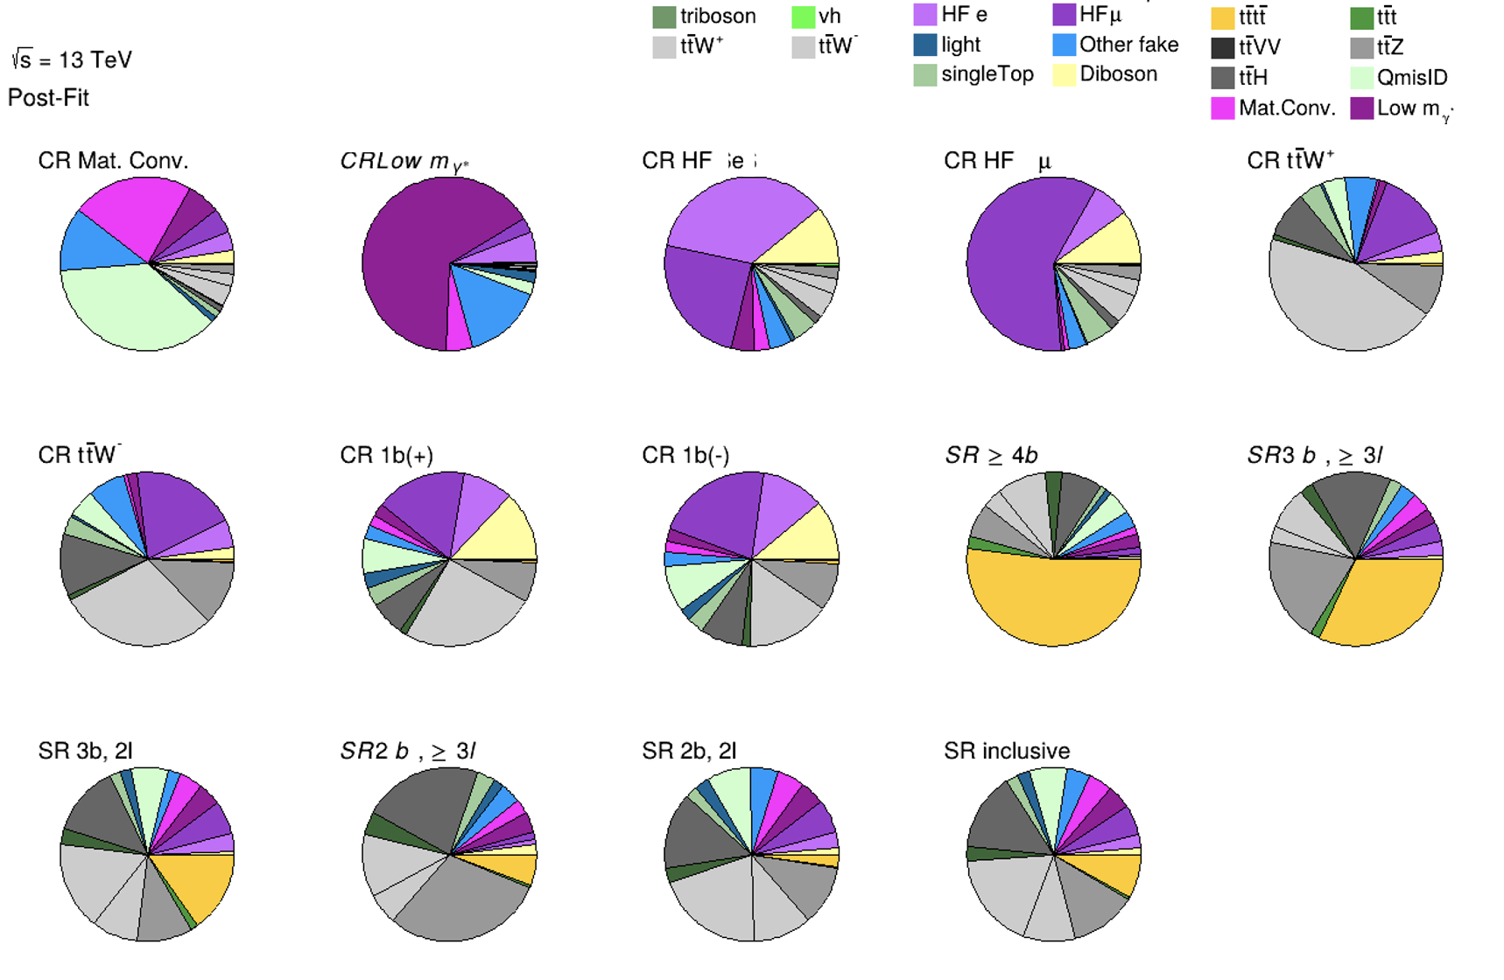
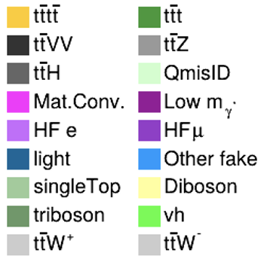
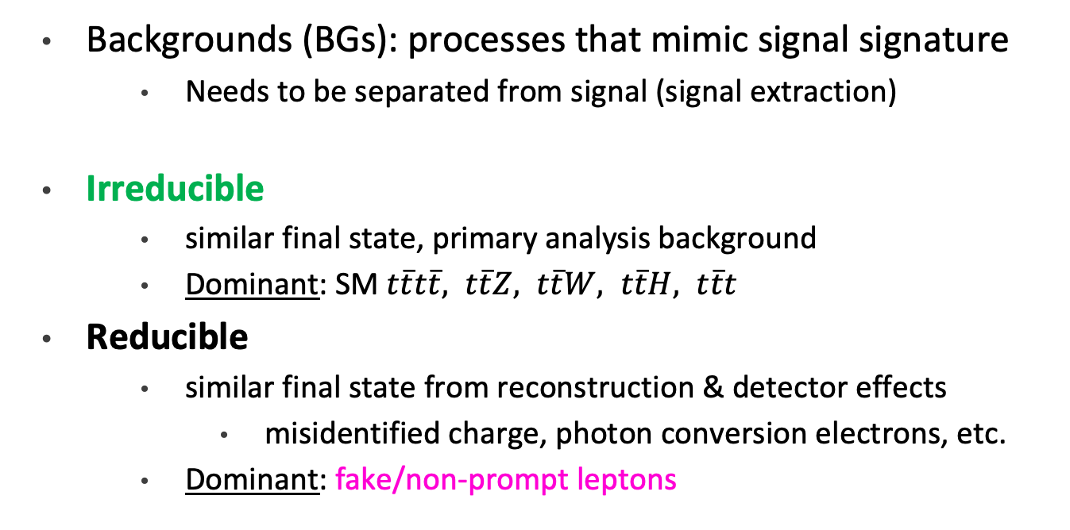
Analysis backgrounds
7%
5%
5%
14%
6%
Backgrounds (BGs): processes that mimic signal signature
Needs to be separated from signal (signal extraction)
Irreducible
similar final state, primary analysis background
Dominant: SM $t\overline{t}t\overline{t}, t\overline{t}Z, t\overline{t}W, t\overline{t}H, t\overline{t}t$
Reducible
similar final state from reconstruction & detector effects
misidentified charge, photon conversion electrons, etc.
Dominant: fake/non-prompt leptons
3%
8%
28%
12%
Notes:
irreducible: same final state, cannot be distinguish purely by reconstruction and detector effects
diboson/triboson: typically reducible since b jets aren’t common decay products, but can have fake b-jets

Slide 17
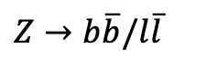
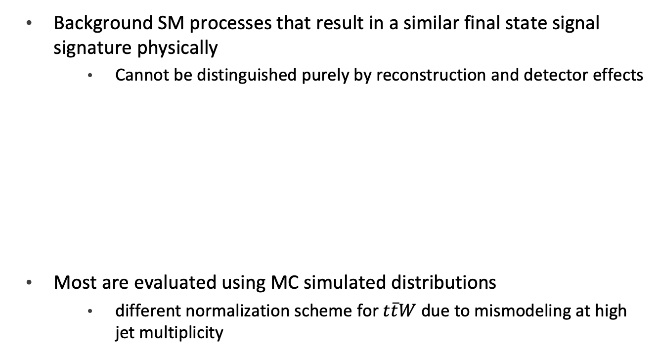
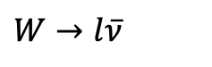
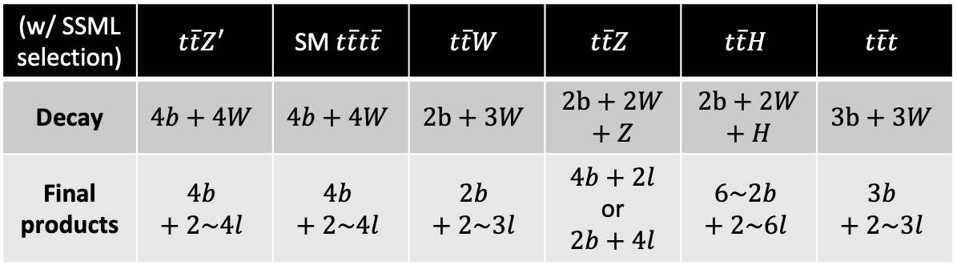
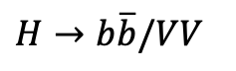
Irreducible background
7%
5%
5%
14%
6%
Background SM processes that result in a similar final state signal signature physically
Cannot be distinguished purely by reconstruction and detector effects
Most are evaluated using MC simulated distributions
different normalization scheme for $t\overline{t}W$ due to mismodeling at high jet multiplicity
3%
8%
28%
12%
(w/ SSML selection) | $$t\overline{t}Z^{′}$$ | $$\text{SM} t\overline{t}t\overline{t}$$ | $$t\overline{t}W$$ | $$t\overline{t}Z$$ | $$t\overline{t}H$$ | $$t\overline{t}t$$
Decay | $$4b+4W$$ | $$4b+4W$$ | $$2b+3W$$ | $$2b+2W+Z$$ | $$2b+2W+H$$ | $$3b+3W$$
Final products | $$4b+2\sim 4l$$ | $$4b+2\sim 4l$$ | $$2b+2\sim 3l$$ | $4b+2l$ or $$2b+4l$$ | $$6\sim 2b+2\sim 6l$$ | $$3b+2\sim 3l$$
$$W→l\overline{ν}$$
$$Z→b\overline{b}/l\overline{l}$$
$$H→b\overline{b}/VV$$
Notes:
SM tttt identical final state
ttW mimics same sign dilepton signature
W rarely decays to qb due to CKM suppression
ttZ mimics SSML
ttt smaller jet multiplicity but similar topology
ttVV final states lots of leptons, contaminates multilepton phase space

Slide 18
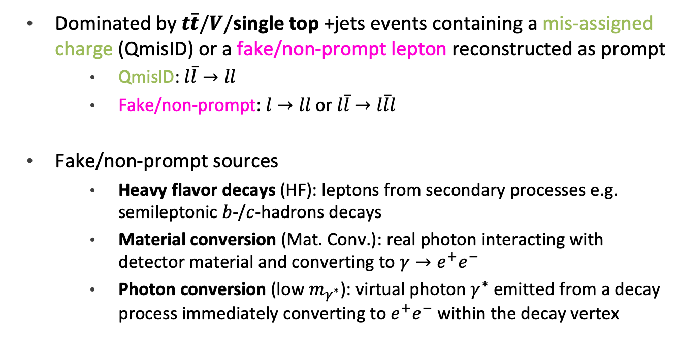
Reducible background
7%
5%
5%
14%
6%
Dominated by $t\overline{t}/V/$single top +jets events containing a mis-assigned charge (QmisID) or a fake/non-prompt lepton reconstructed as prompt
QmisID: $l\overline{l}→ll$
Fake/non-prompt: $l→ll$ or $l\overline{l}→l\overline{l}l$
Fake/non-prompt sources
Heavy flavor decays (HF): leptons from secondary processes e.g. semileptonic $b$-/$c$-hadrons decays
Material conversion (Mat. Conv.): real photon interacting with detector material and converting to $γ→e^{+}e^{−}$
Photon conversion (low $m_{γ^{∗}}$): virtual photon $γ^{∗}$ emitted from a decay process immediately converting to $e^{+}e^{−}$within the decay vertex
3%
8%
28%
12%
Notes:
HF decays example: top decays to bottom, bottom hadronizes, b-hadrons decays to lepton
material ~ external, photon ~ internal
conversion: lepton pair production from photon, usually electron, can produce muon if high enough energy
virtual photon has low invariant mass

Slide 19
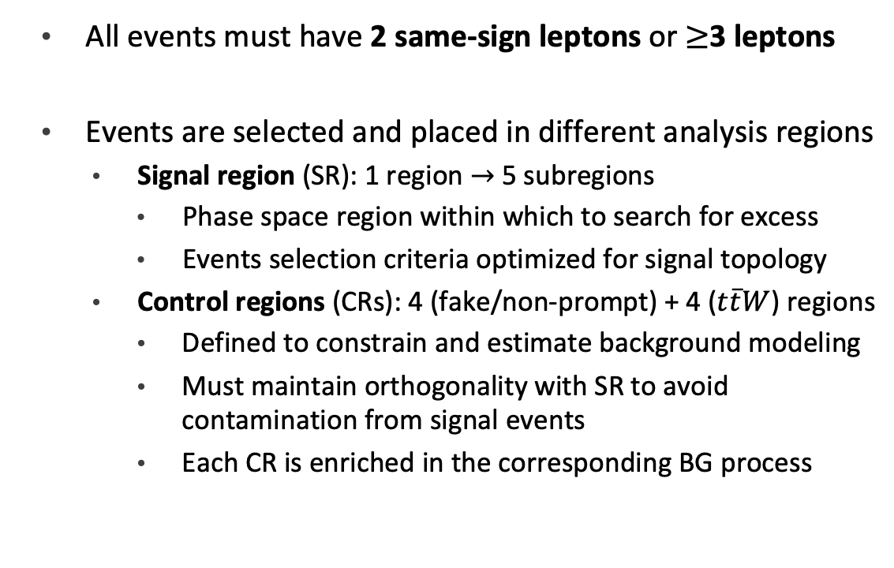
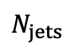
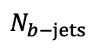
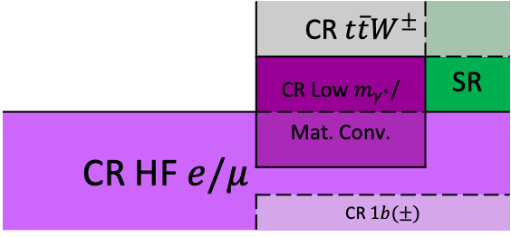
Analysis regions
All events must have 2 same-sign leptons or $≥$3 leptons
Events are selected and placed in different analysis regions
Signal region (SR): 1 region $→$ 5 subregions
Phase space region within which to search for excess
Events selection criteria optimized for signal topology
Control regions (CRs): 4 (fake/non-prompt) + 4 ($t\overline{t}W$) regions
Defined to constrain and estimate background modeling
Must maintain orthogonality with SR to avoid contamination from signal events
Each CR is enriched in the corresponding BG process
$$N_{b−jets}$$
 | CR $t\overline{t}W^{±}$
 | CR Low $m_{γ^{∗}}$/ | SR
CR HF $e/μ$ | Mat. Conv.
 | CR $1b(±)$
2
1
1
2
3
4
5
6
$$N_{jets}$$
Notes:
SR cuts e.g. multileptons, high pT, etc.
orthogonal: goal is to use CR to estimate background in SR as accurately as possible, not possible if region contaminated with signal

Slide 20
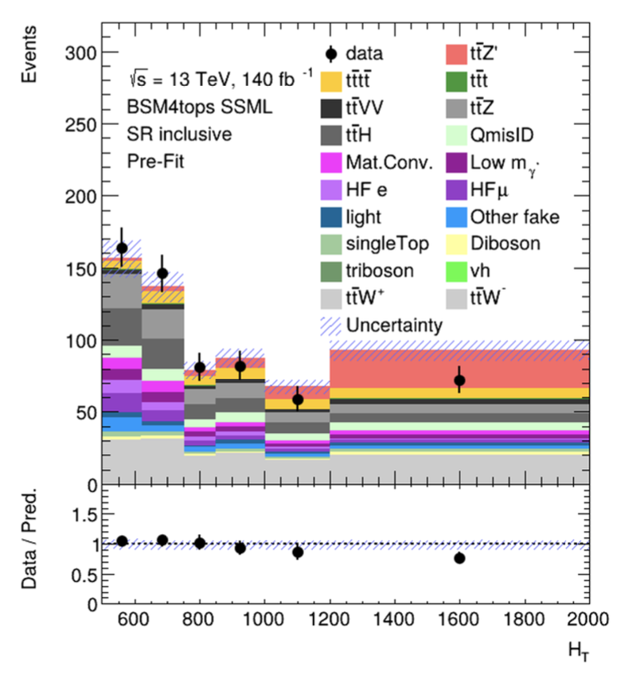
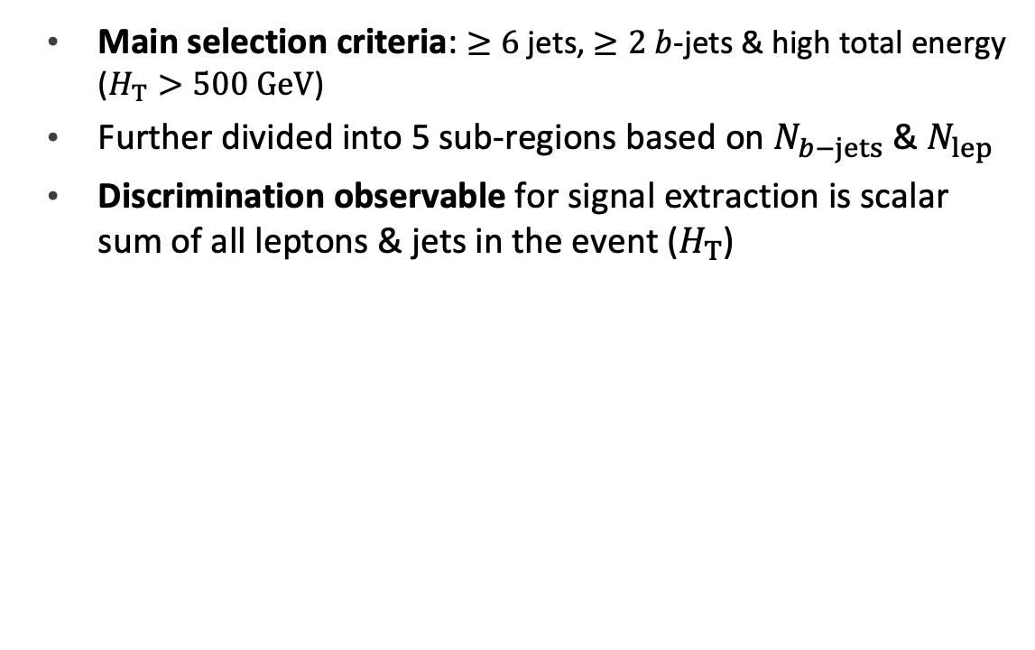
Signal region
Main selection criteria: $≥6$ jets, $≥2$ $b$-jets & high total energy ($H_{T}>500 GeV$)
Further divided into 5 sub-regions based on $N_{b−jets}$ & $N_{lep}$
Discrimination observable for signal extraction is scalar sum of all leptons & jets in the event ($H_{T}$)
Notes:
background: ttW, ttZ, non-prompt leptons, charge mis id

Slide 21
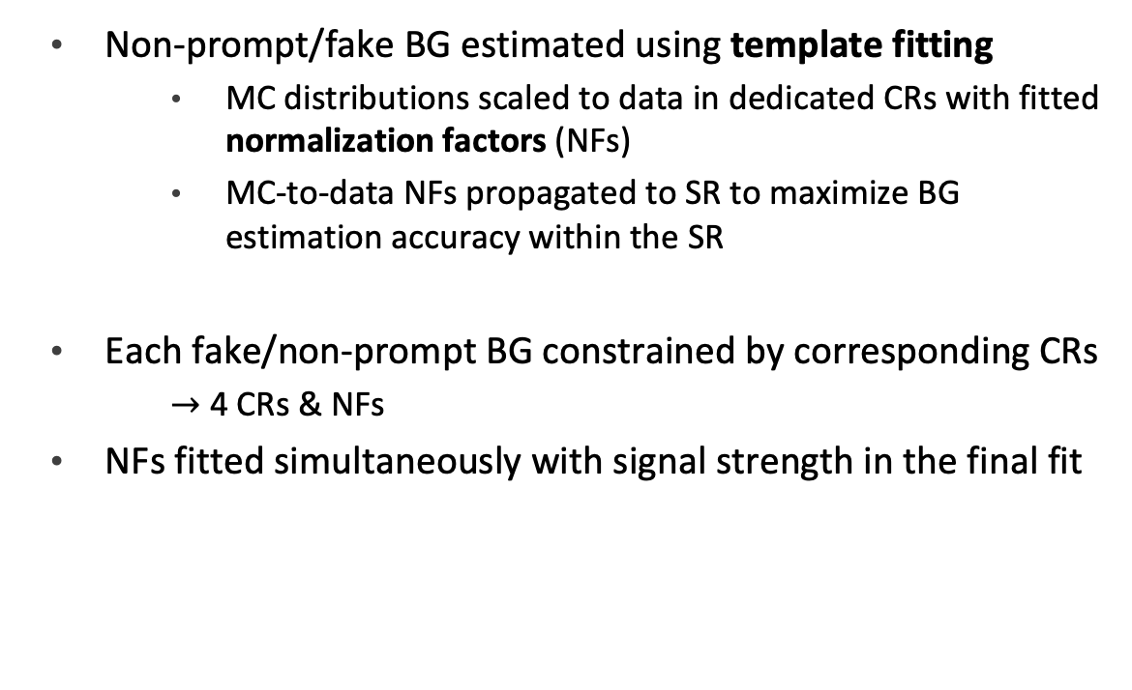
Control regions: Non-prompt/fake
Non-prompt/fake BG estimated using template fitting
MC distributions scaled to data in dedicated CRs with fitted normalization factors (NFs)
MC-to-data NFs propagated to SR to maximize BG estimation accuracy within the SR
Each fake/non-prompt BG constrained by corresponding CRs
$→$ 4 CRs & NFs
NFs fitted simultaneously with signal strength in the final fit
Notes:
NFs propagated to SR to maximize accuracy of BG distributions
template fitting used for complex BGs or BGs with poor MC modeling
dedicated CR to constraint normalization since signal is weak compared to BG, must be as accurate as possible

Slide 22
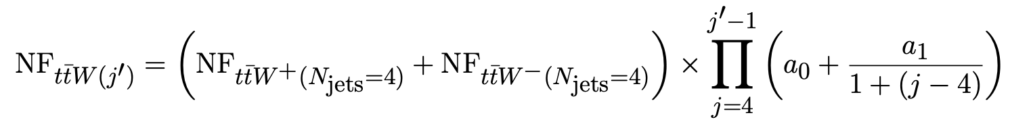

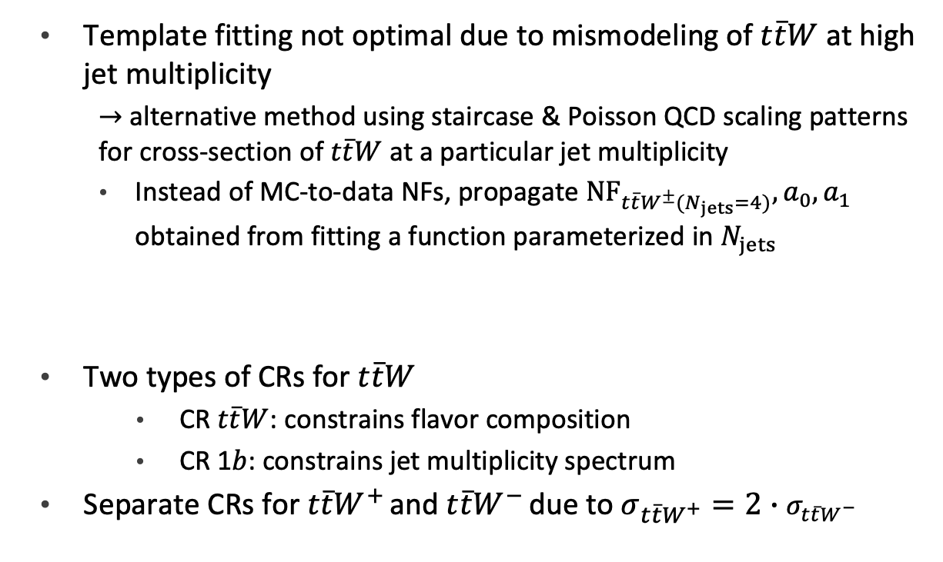
Control regions: $t\overline{t}W$
Template fitting not optimal due to mismodeling of $t\overline{t}W$ at high jet multiplicity
$→$ alternative method using staircase & Poisson QCD scaling patterns for cross-section of $t\overline{t}W$ at a particular jet multiplicity
Instead of MC-to-data NFs, propagate ${NF}_{t\overline{t}W^{±}(N_{jets}=4)}, a_{0}, a_{1}$ obtained from fitting a function parameterized in $N_{jets}$
Two types of CRs for $t\overline{t}W$
CR $t\overline{t}W$: constrains flavor composition
CR 1$b$: constrains jet multiplicity spectrum
Separate CRs for $t\overline{t}W^{+ }$and $t\overline{t}W^{− }$due to $σ_{t\overline{t}W^{+}}=2∙σ_{t\overline{t}W^{−}}$
Notes:
mismodeling = excess observed at high njets compared to modeling
data driven method also switches ttW systematic uncertainties from predominanly modeling to statistical
applied to each jet in addition to the ones from the hard scattering process
ttW matrix element for same sign dilepton gives 4 jets in the hard process -> starts at 4
exclusive jet cross section: cross section of events with exactly N jets
staircase scaling: ratio of exclusive cross sections for successive jet multiplicities is constant i.e. each additional jet is equally likely as the last
sensitive to high jet multiplicity
Poisson scaling: follows Poisson distribution in jet multiplicity -> increasing suppression of high jet multiplicities
sensitive to low jet multiplicity

Slide 23
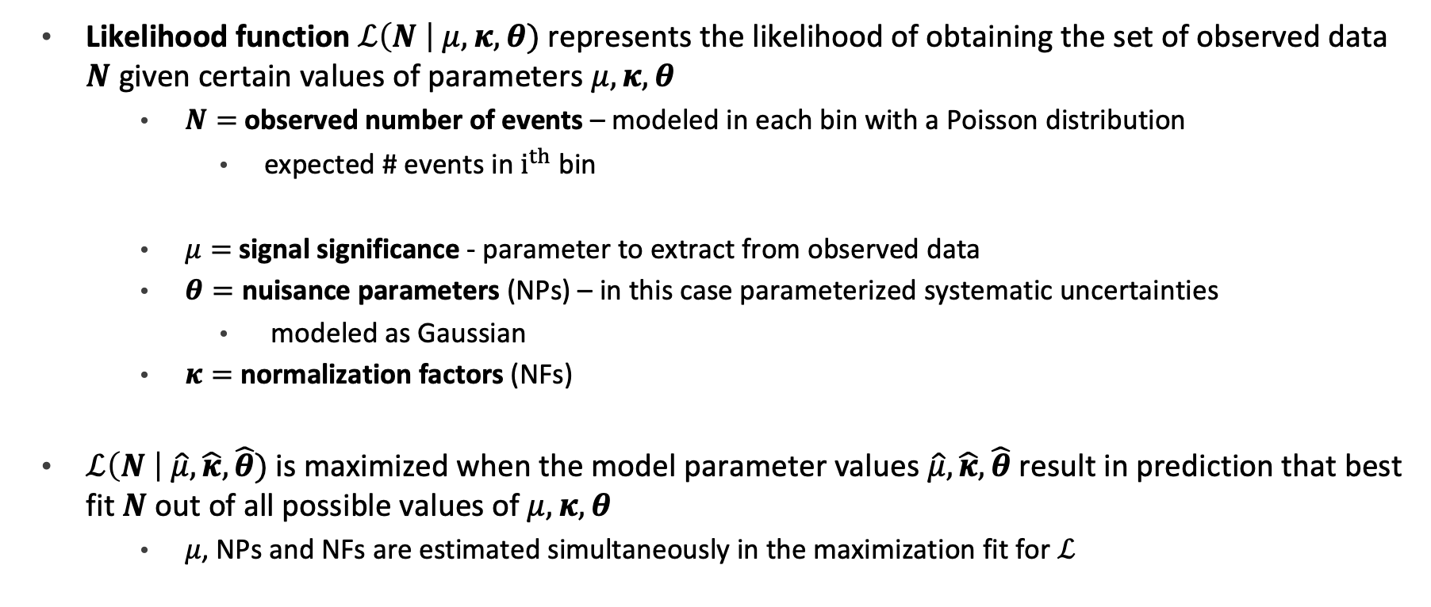
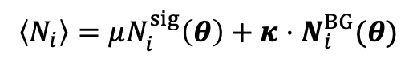
Statistical methods: Likelihood function
Likelihood function $ℒ\left(N \right| μ,κ,θ)$ represents the likelihood of obtaining the set of observed data $N$ given certain values of parameters $μ,κ,θ$
$N=$ observed number of events – modeled in each bin with a Poisson distribution
expected # events in $i^{th}$ bin
$μ=$ signal significance - parameter to extract from observed data
$θ=$ nuisance parameters (NPs) – in this case parameterized systematic uncertainties
modeled as Gaussian
$κ=$ normalization factors (NFs)
$ℒ\left(N \right| \hat{μ},\hat{κ},\hat{θ})$ is maximized when the model parameter values $\hat{μ},\hat{κ},\hat{θ}$ result in prediction that best fit $N$ out of all possible values of $μ,κ,θ$
$μ$, NPs and NFs are estimated simultaneously in the maximization fit for $ℒ$
$$\left\langle N_{i}\right\rangle =μN_{i}^{sig}\left(θ\right)+κ⋅N_{i}^{BG}(θ)$$
Notes:
bolded = vector
$\hat{μ}$ then represents the best estimate of the signal strength under a model (Poisson event counting) given the observed data
$\hat{μ},\hat{κ},\hat{θ}$ are unknown constants for a given set of observed data

Slide 24
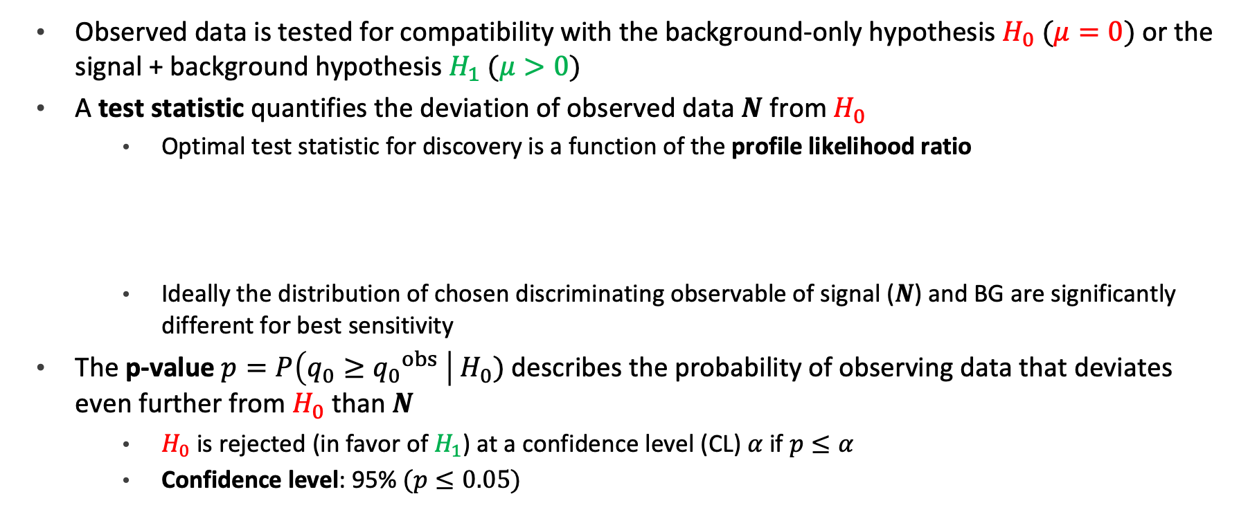
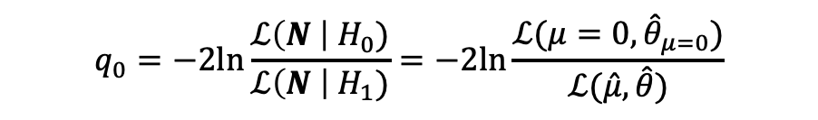
Statistical methods: Profile likelihood
Observed data is tested for compatibility with the background-only hypothesis $H_{0}$ $(μ=0)$ or the signal + background hypothesis $H_{1}$ $(μ>0)$
A test statistic quantifies the deviation of observed data $N$ from $H_{0}$
Optimal test statistic for discovery is a function of the profile likelihood ratio
Ideally the distribution of chosen discriminating observable of signal ($N$) and BG are significantly different for best sensitivity
The p-value $p=P\left(q_{0}≥{q_{0}}^{obs} \right| H_{0})$ describes the probability of observing data that deviates even further from $H_{0}$ than $N$
$H_{0}$ is rejected (in favor of $H_{1}$) at a confidence level (CL) $α$ if $p≤α$
Confidence level: 95% $(p≤0.05)$
$$q_{0}=−2ln\frac{ℒ\left(N \right| H_{0})}{ℒ\left(N \right| H_{1})}=−2ln\frac{ℒ(μ=0,{\hat{θ}}_{μ=0})}{ℒ(\hat{μ},\hat{θ})}$$
Notes:
$\hat{μ}$ then represents the best estimate of the signal strength under a model (Poisson event counting) given the observed data

Slide 25
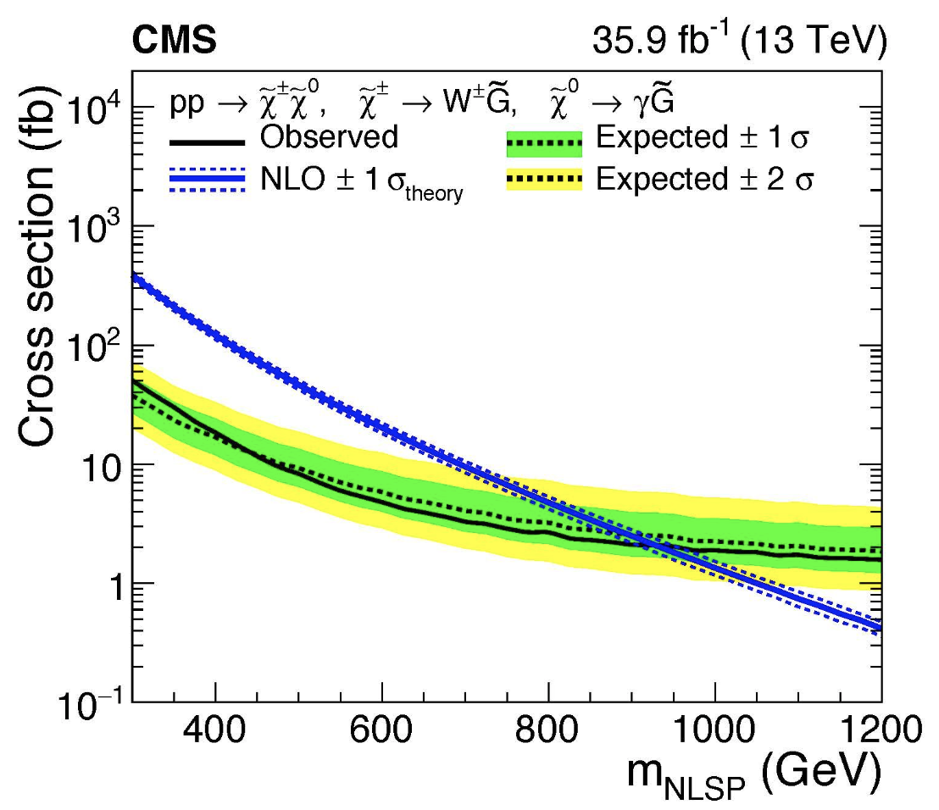
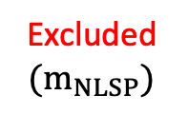
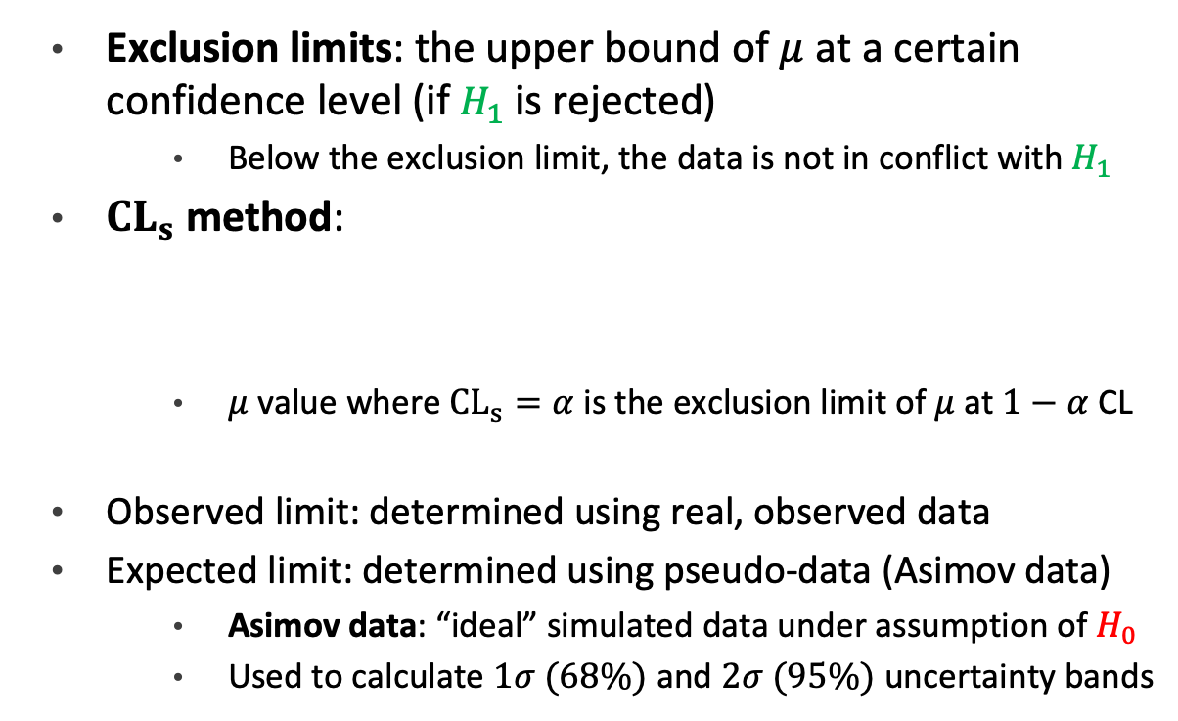




Statistical methods: Exclusion limits
Exclusion limits: the upper bound of $μ$ at a certain confidence level (if $H_{1}$is rejected)
Below the exclusion limit, the data is not in conflict with $H_{1}$
$CL_{s}$ method:
$μ$ value where $CL_{s}=α$ is the exclusion limit of $μ$ at $1−α$ CL
Observed limit: determined using real, observed data
Expected limit: determined using pseudo-data (Asimov data)
Asimov data: “ideal” simulated data under assumption of $H_{0}$
Used to calculate $1σ (68\%)$ and $2σ (95\%)$ uncertainty bands
Excluded $(μ)$
$$CL_{s}=\frac{P\left(q_{0}≥{q_{0}}^{obs} \right| H_{1})}{P\left(q_{0}≥{q_{0}}^{obs} \right| H_{0})}$$
Not excluded $(μ)$
Excluded $(m_{NLSP})$
Not excluded $(m_{NLSP})$
Notes:
$ℒ\left(N \right| μ,κ,θ)$ = likelihood of observing N with parameter values $μ,κ,θ$
production of CMS supersymmetric partner search (next-to-lightest susy partner – NLSP)
blue line = theoretical cross section
masses below 900 GeV is excluded
Asimov data: does not include statistical fluctuations
calculate expected limits, significance, evaluate expected sensitivity
injection: adding signal events to Asimov data to evaluate signal injection recovery, validate statistical procedure, sensitivity study by injecting at different cross sections

Slide 26
Results

Slide 27



Normalization & scaling factors
No significant variation is observed in fit output behavior using $t\overline{t}Z′$ samples of different $m_{Z^{′}}$
Nominal pre-fit values: $NF=1; a_{0}=a_{1}=0$
Notes:
No significant difference between results obtained using different mass points
2 GeV results showed without significant loss of generality
The fitted background NFs are consistent with their nominal values within one standard deviation, or two standard deviations in the case of NFHF e and NF ̄ ttW+4j

Slide 28


Background modeling: Fake/non-prompt
Notes:
lower panel = ratio of data to post fit predictions
dashed line = prefit bg
shaded area = post fit uncertainty
good agreement between data and post fit backgrounds

Slide 29


Background modeling: Fake/non-prompt
Notes:
lower panel = ratio of data to post fit predictions
dashed line = prefit bg
shaded area = post fit uncertainty
good agreement between data and post fit backgrounds

Slide 30



Background modeling: $t\overline{t}W$
Notes:
lower panel = ratio of data to post fit predictions
dashed line = prefit bg
shaded area = post fit uncertainty
good agreement between data and post fit backgrounds

Slide 31


Background modeling: $t\overline{t}W$
Notes:
lower panel = ratio of data to post fit predictions
dashed line = prefit bg
shaded area = post fit uncertainty
good agreement between data and post fit backgrounds

Slide 32

Background yields
Notes:
ttW no prefit since nominal scaling factor is set to 0
except for HF e, pre and post fit variations consistent within 1sigma
HF e lowered within 2 sigma, can be related to NF HFe but has negligible impact on mu

Slide 33

Uncertainty impact
Notes:
impact on signal strength, grouped by categories
impact = how much a NP affect the signal strength when it’s shifted
impact evaluated for each uncertainty by refitting with corresponding set of nuisance parameters fixed to their best fit values and varied by 1sigma and see how mu fluatuate

Slide 34

Uncertainty pull
Notes:
pull = difference between nominal and post fit values for a NP
large pull can mean mismatch between model & data or NP is constrained by data
only modeling uncertainties shown since experimental uncertainties have minimal pull
largest pulls: tttt generator choice & xsec, ttZ generator choice, diboson cross section

Slide 35


Exclusion limits
No significant excess over SM predictions is observed
Fitted signal strength $μ$ is compatible with zero for all $Z′$ mass points
Observed limits $[7.9, 9.44]$ depending on $m_{Z^{′}}$
Mass exclusion: $m_{Z^{′}}≲1.5 TeV$
Notes:
limit on mu -> limit on cross section times branching ratio
region above line is excluded for cross section

Slide 36

Summary
A search for BSM top-philic heavy resonance based on a simplified top-philic color singlet $Z′$ is conducted in the same-sign dilepton and multilepton final states of the top-quark pair associated production channel $(t\overline{t}Z′)$
The search probed a $Z^{′}$ mass range from $1 TeV$ to $3 TeV$ under the assumption of a top-$Z^{′}$ coupling strength of $c_{t}=1$ and chirality angle $θ=π/4$
New data-driven estimation techniques for $t\overline{t}W$ and charge misidentification backgrounds are employed to improve background modeling and signal sensitivity
No significant excess over SM predictions is observed
Exclusion limits are placed on $t\overline{t}Z′$ cross section at 95% CL, the most stringent limits to date
Previous limits: $σ_{t\overline{t}Z^{′}}=21 fb$ in the 1LOS channel with $m_{Z^{′}}=2.5 TeV; θ=π/2$
Notes:
background: ttW, ttZ, non-prompt leptons, charge mis id

Slide 37

Outlook
Discovery potential in future searches is expected to increase with further improvements in analysis strategies
e.g. multivariate NN-based signal extraction techniques, background modeling improvements
Run 3 data will have increased center-of-mass energy at $13.6 TeV$
$19\%$ increase in $pp→t\overline{t}t\overline{t}$ cross section
integrated luminosity increase by a factor of 2
$159.8 fb^{−1}$ recorded by 09/2024
High Luminosity – LHC prospects will enhance sensitivity to BSM physics
Notes:
background: ttW, ttZ, non-prompt leptons, charge mis id

Slide 38
Thank you for listening!

Slide 39
Backup slides

Slide 40
Terminology
Sensitivity: measures how well an analysis can detect the targeted signal
Significance: measures how the likelihood of the data not being random noise
Channel: a specific way a particle interact or decay
Final state: set of final particles of a process detected by the detector
Coupling: interaction strength → cross section
Reconstruction: using raw signals to reenact physics processes that happened
Scale/normalization factors:
Monte Carlo simulation
Selection cuts:
Parton shower: cascade of partons and jets from high energy partons emission
Hadronization:
Notes:
additional terminologies to explain later
working points
analysis regions
ssml
conversion leptons

Slide 41


$Z^{′}$ and $t\overline{t}X$: ATLAS results
General top-philic heavy resonance decaying into a $t\overline{t}$pair
No significant excess over background expectation observed
Using a simplified heavy $Z^{′}$ mode: observed (expected) upper limits at 95% CL of $σ_{Z^{′}} × {BR}_{Z^{′}}∈\left[21 \left(14\right), 119 \left(86\right)\right] fb$ for $M_{Z^{′}}∈\left[100, 3000\right] GeV$
$t\overline{t}H/A$ search, multilepton channel
No significant excess over background expectation observed
Obs (exp) upper limits at 95% CL of $σ_{t\overline{t}H/A} × {BR}_{H/A→t\overline{t}} ∈\left[14 \left(10\right), 6 \left(5\right)\right] fb$ for $M_{H/A}∈\left[400, 1000\right] GeV$
$t\overline{t}t\overline{t}$ cross section measurements
Obs (exp at NLO) cross section $σ_{t\overline{t}t\overline{t}}={22.5}_{−5.5}^{+6.6}\text{ (}{12}_{−2.5}^{+2.2}\text{) }\text{fb}$
Obs (exp) significance $6.1σ (4.3σ$)

Slide 42

LHC: What’s next?

Slide 43

Object selection
Notes:
background: ttW, ttZ, non-prompt leptons, charge mis id

Slide 44


Flavor tagging
Identification of jets containing $b$-, $c$- or light-hadrons
Special properties of $b$-hadrons
characteristic long lifetime $→$ secondary decay vertex
high decay multiplicity
Operating points (OPs): binary discriminant cuts
$65/70/77/85/90\%$ $b$-tagging efficiency
Trade-off between tagging efficiency and rejection rate
Notes:
trade off: b-tagging efficiency vs. b-jet purity/c- or light-jet rejection/mistag rate

Slide 45

Region selection
Notes:
2 b-jets and not 4: not 100% b-tagging efficiency
tight selection: lepton isolation discriminant to separate prompt & non prompt leptons
irreducible ~85%
reducible ~15%
ttZ ttH ttt others: estimated by normalizing MC to measured SM cross section
floating ttW
• the large +jets background normalisation factor found in recent measurements in a similar phase space ttH(H→multileptons)
• the effect of missing electroweak corrections in the MC simulation
$e/μ$ from heavy flavor decays (~12%)
electrons from photon conversion in the detector (6.8%)
pair production from a virtual photon
charge mis-identification (5.8%)
non-prompt leptons = leptons not originating from the main collision/not a direct decay product, or a mistagged jet from whatever
material conversion photon = pair production in material
charge misID = relevant for 2lss channel, caused by
• Bremsstrahlung photon emission followed by its conversion
• Mis-measured track curvature
rate parameterized as a function of electron $p_{T}$ and $|η|$
estimated with data driven method using Z->e+-e+-/e+-e-+ ratio

Slide 46


Control regions: $t\overline{t}W$
Template fitting not optimal due to mismodeling of $t\overline{t}W$ at high jet multiplicity
$→$ alternative method using staircase & Poisson QCD scaling patterns for cross-section of $t\overline{t}W$ at a particular jet multiplicity
Instead of MC-to-data NFs, propagate ${NF}_{t\overline{t}W^{±}(N_{jets}=4)}, a_{0}, a_{1}$ obtained from fitting a function parameterized in $N_{jets}$
Two types of CRs for $t\overline{t}W$
CR $t\overline{t}W$: constrains flavor composition
CR 1$b$: constrains jet multiplicity spectrum
Separate CRs for $t\overline{t}W^{+ }$and $t\overline{t}W^{− }$due to $σ_{t\overline{t}W^{+}}=2∙σ_{t\overline{t}W^{+}}$
Notes:
applied to each jet in addition to the ones from the hard scattering process
ttW matrix element for same sign dilepton gives 4 jets in the hard process -> starts at 4
exclusive jet cross section: cross section of events with exactly N jets
staircase scaling: ratio of exclusive cross sections for successive jet multiplicities is constant i.e. each additional jet is equally likely as the last
sensitive to high jet multiplicity
Poisson scaling: follows Poisson distribution in jet multiplicity -> increasing suppression of high jet multiplicities
sensitive to low jet multiplicity

Slide 47
Signal yields
Notes:
background: ttW, ttZ, non-prompt leptons, charge mis id

Slide 48
Uncertainty pull
Notes:
background: ttW, ttZ, non-prompt leptons, charge mis id

